Slide 1
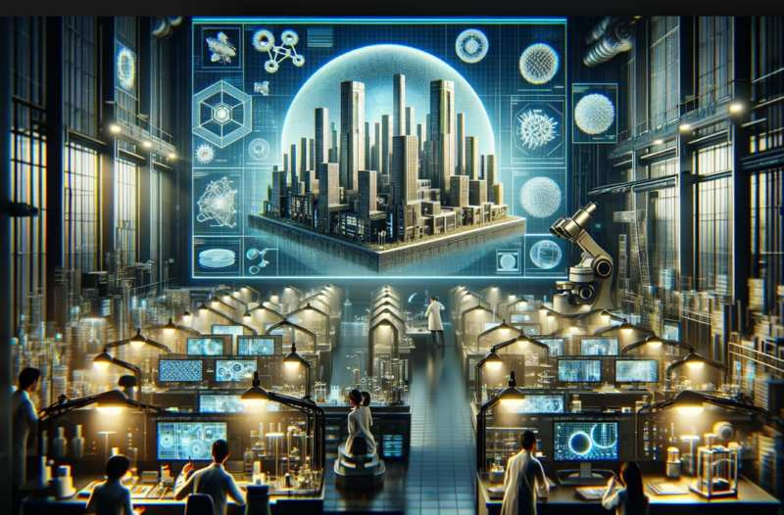

Nanotechnology in Building Applications:
Key to a Sustainable Future
Jennifer Pekarek

Slide 2
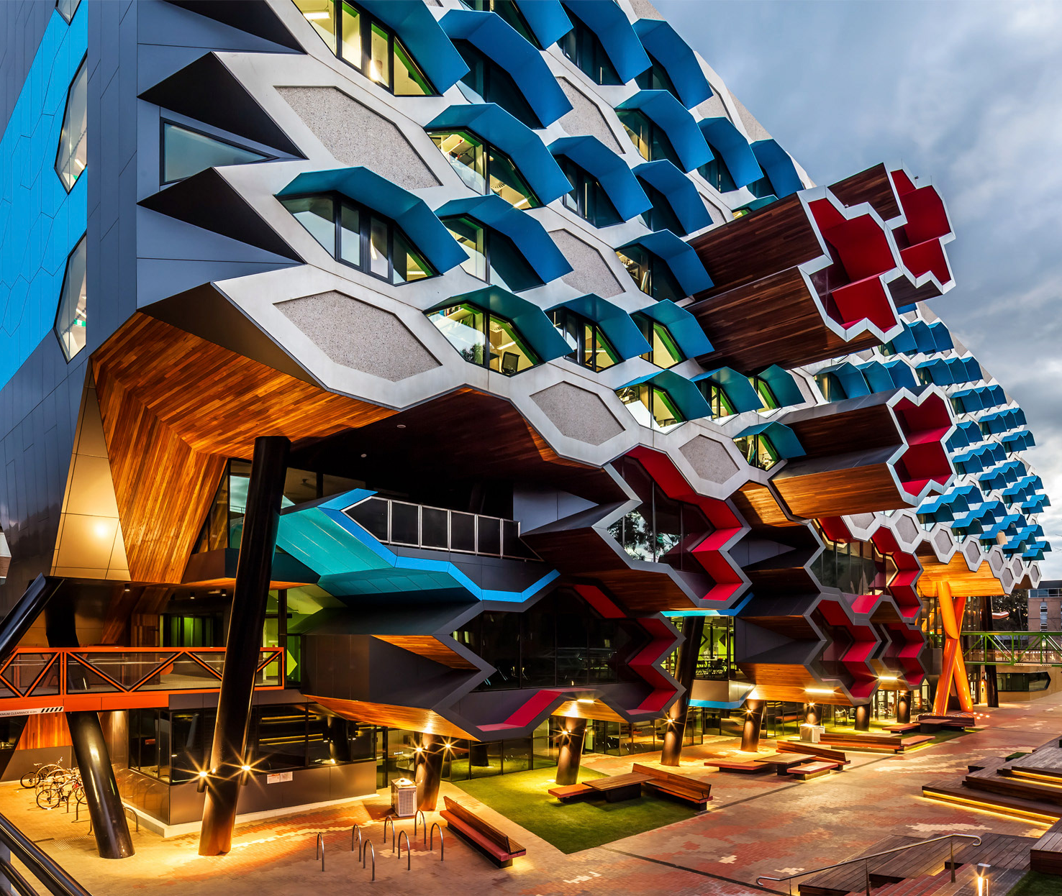
Table of Contents
3
4
5
6
7
8
9
10
11
12
13
14
15
16
17
An Exciting Past
An Uncertain Future
A Viable Solution
Less Is Less
The Problem with Cement
Benefits of Nanotechnology – Cement
The Problem with Wood
Benefits of Nanotechnology – Wood
The Problem with Glass
Benefits of Nanotechnology – Glass
Imagine
TruTint
Climate Positive
Conclusion
References

Slide 3
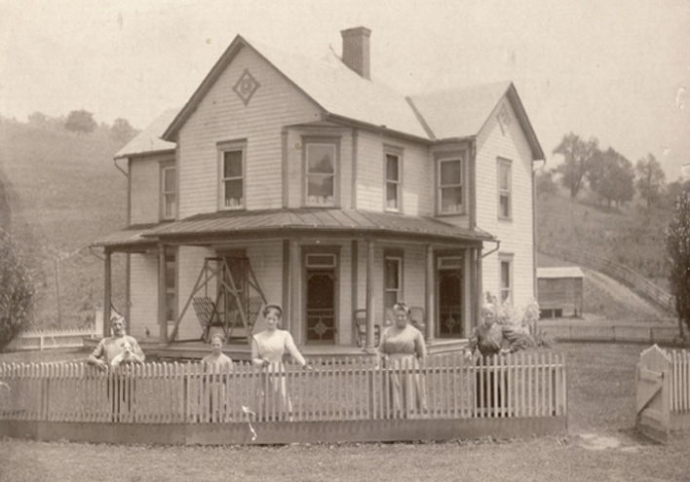

An exciting past
The architectural industry has always been dictated by the limitations of materials available and the technology currently developed in the building sciences field. This field has seen a surge of new information since the 1900’s, resulting in a seemingly endless array of options when it comes to building structures.
Prior to the 1900’s, structures were built and designed in a way that to allowed the spaces within them to be heated by means of stoves, chimneys and fireplaces. This all changed in 1902 when a man named Willis Carrier was asked to remedy a humidity control problem in a printing plant. The device he created not only fixed the problem, it opened the door to something no one knew was possible.
The architectural world itself was revolutionized with the implementation of HVAC, air conditioning and other systems that allowed structures to self heat and cool. This led to structures built with floor to ceiling glass walls, because mankind could, and why not? These structures are stunning to say the least.

Slide 4
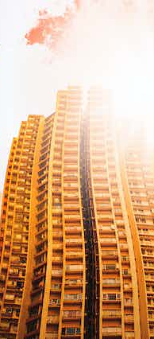


An Uncertain
Future
In time, oil and gas prices began to surge, and these floor to ceiling glass walled structures became a problem once again. A problem of finances. Energy efficiency became a topic of conversation in the design stage of structures and mankind worked on adapting to a new need.
?
Fast forward a few more decades and the problem of energy efficiency has become an urgent dilemma. As we face increasing temperature surges both on land and in our oceans globally, from extreme lows to extreme highs, global focus to find any and all sustainable options have become top priority in all things.

Slide 5

A viable solution
With so much attention being put forth to heal this planet we all live on, solutions involving technological advances are popping up left, right and center. There are many viable candidates, some of which are already in operation.
One up and coming field that is of particular interest, is that of nanotechnology. Its potential is still being realized to a great degree, but even its current prospects have huge potential as viable solutions to this global crisis.
It is said that the building industry alone is the largest contributor to emissions, not to mention the ongoing contributions each built structure continues to emit. What options does nanotechnology offer to help in this field?

Slide 6

Less is not more….not the same…. Its less.
That’s reaching the goal!
Water, dirt, pretty much anything repels away from products containing, or coated by nano particles. This means no water or time wasted on cleaning residue off.
Materials built containing nano particles are stronger than their counterparts. With more strength achieved, this allows us to build sturtures with sufficient strength using less materials.
Less material usage equals less waste, and less waste equals less damage to the earth.

Slide 7
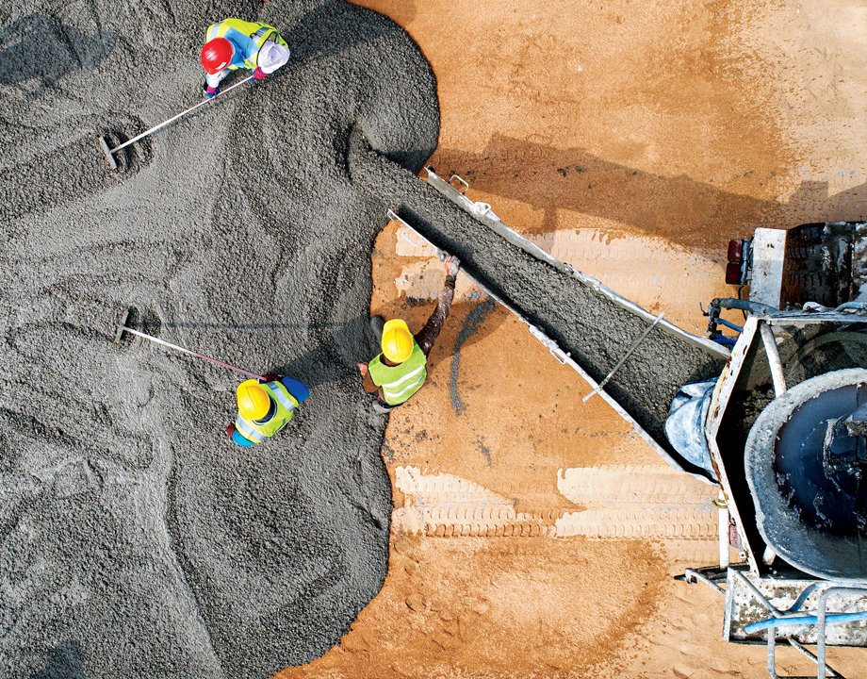
The Problem with Cement
8%
Of worldwide CO₂ emissions in 2016
2nd
Most consumed material in the world
1.6
Tonnes of raw materials are consumed per 1 tonne of Portland cement production
$
0.8
Tonnes of CO₂ emissions are released per 1 tonne of Portland cement production

Slide 8
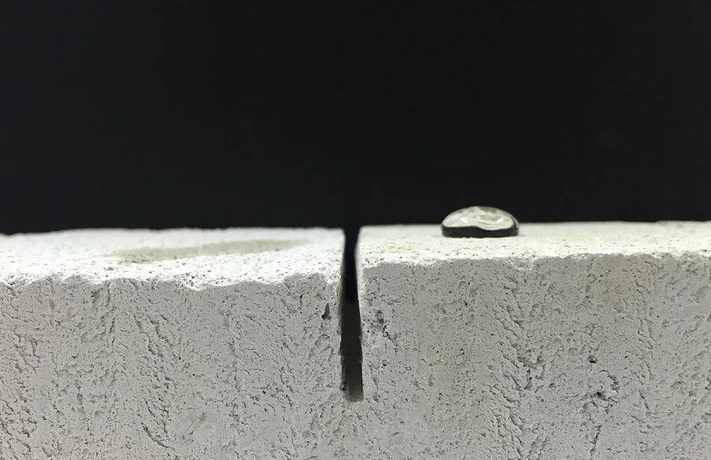
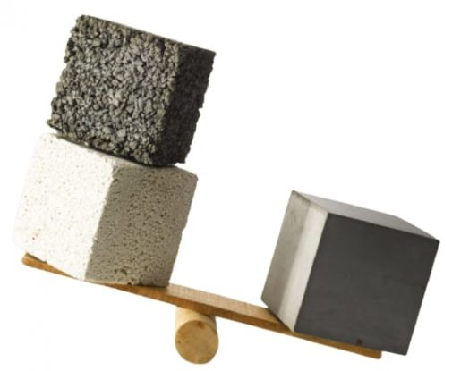
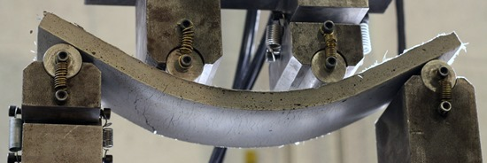
Benefits of Nanotechnology - CEMENT
  The benefits of nano cement depend on the nanomaterials that are used.
  For instance, CNTs, CNFs, graphene, and GO nanomaterials offer:
  tensile strength,
  elasticity,
  electrical & thermal conductivity
  On the other hand, nano-silica (nano-SiO₂) & nano-calcium carbonate (nano-CaCO₃) offer
  hydration acceleration for cement-based materials
  In addition to these benefits, the use of nano materials in cement can:
  reduce the overall weigh,
  Self-compact,
  improve air quality,
  self-clean,
  self-heal,
  self-sense,
  offer increased durability

Slide 9
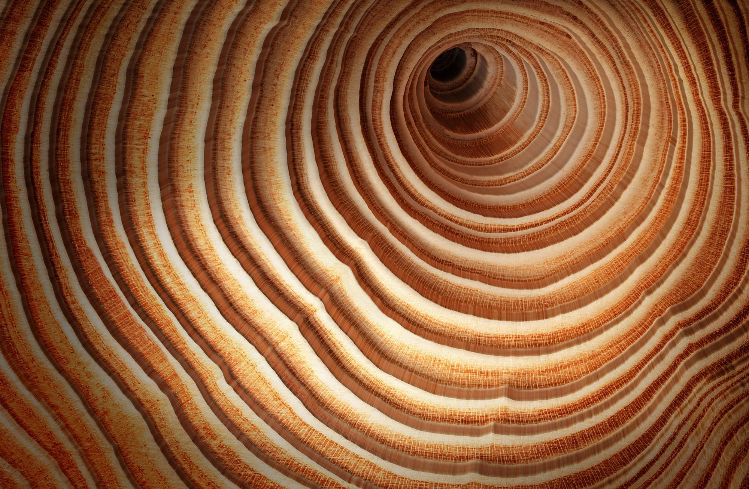
The Problem with Wood
Water
Fire
Susceptible to damage by:
Infestation
Decay
Use of wood products that are not used sustainably also contribute to problems arising from deforestation.

Slide 10


Benefits of Nanotechnology
- WOOD
More durable
Less water absorbent
More fire resistant
Better UV absorption
Better mechanical properties

Slide 11

The Problem with Glass
Summertime Heat Gain
Highly Breakable
High Cleaning Maintenance
Wintertime Heat Loss
No Privacy
Glare and Fading Issues

Slide 12
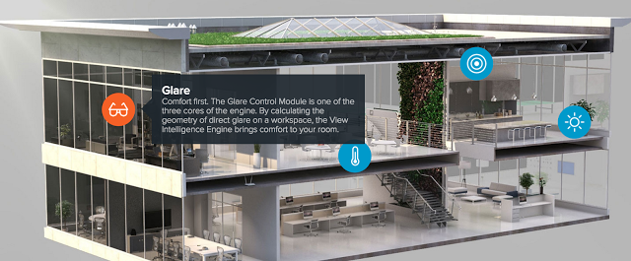
Benefits of Nanotechnology
- GLASS
Its STRONGER
Its UV resistant
Its Self-Cleaning
It can control internal temperatures
Its abrasion resistant
…and so much more is on the horizon….

Slide 13

ceiling
glass walled
structures
again…
to
Imagine:
Floor

Slide 14

Tru-Tint … a game changer
A new nano glass product on the market, “TruTint” is about to usher in a new era in architecture.
Fast Switching technology enabled
10x Lower Cost than conventional glass
Capable of cutting building CO2 emissions by 40%
User enabled color, temperature & infinite tint change capability
Adaptable to temperature & infrared controlled
Orients with applied voltage

Slide 15
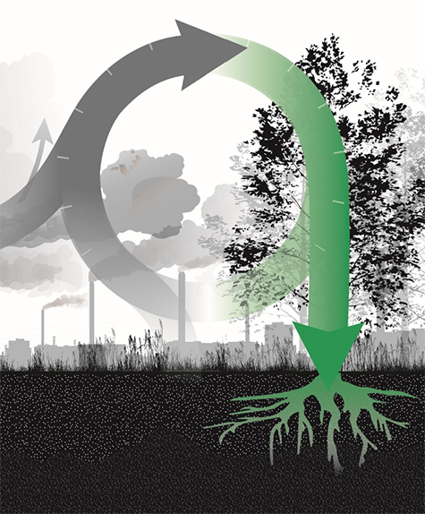
Forget net zero… think “Climate positive”
40%
Up to
1.24
72%
Less emissions
& energy usage
Gigaton reduced CO2 emissions per year
Lower CO2 emissions
When buildings use Glass nanotechnology products like “TruTint” rather than standard glass windows.
When using GPC (geopolymer concrete) instead of conventional Portland Cement Concrete.
When using Wood nanotechnology products like “MettleWood” to replace steel and concrete in construction.
Marry these new nanomaterial products with already in use solar, wind and other sustainable energy products and we’ll soon be looking at a net positive climate bank!

Slide 16

Nanotechnology is the future, so let’s make it a better one.
Integrating nano building materials into each project is our key to sustainability.
Thank you.
Jennifer Pekarek
jenpekarek@jparchtech.com
www.jparchtech.com

Slide 17
References:
(2023, January 23). Nano-Architecture: Designing on a Microscopic Scale. Designer Views. Retrieved December 16, 2023, from https://www.designerviews.org/Nano-Architecture:-Designing-on-a-Microscopic-Scale/I225.htm
(2023, January 23). The Evolution of HVAC Systems: From the Industrial Era to Today and Beyond. King. Retrieved December 16, 2023, from https://www.kingheating.com/blog/the-evolution-of-hvac-systems-from-the-industrial-era-to-today-and-beyond
Hollingham, R. (2023, May 17). Apollo: How Moon missions changed the modern world. BBC. Retrieved December 16, 2023, from https://www.bbc.com/future/article/20230516-apollo-how-moon-missions-changed-the-modern-world
Barmann, J. C. (2022, May 7). How the glass curtain wall was born. Curbed San Francisco. Retrieved December 16, 2023, from https://sf.curbed.com/2018/3/7/17073432/hallidie-building-glass-curtain-history-san-francisco
Lindell, J. Twitter [Photograph]. https://twitter.com/johnlindell/status/949335147480043520
(2022, February 23). Oil Prices Are Surging Again. What Does it Mean? Third Way. Retrieved December 16, 2023, from https://www.thirdway.org/blog/oil-prices-are-surging-again-what-does-it-mean
LJS, E. Global Warming vs Climate Change [Photograph]. Adobe Stock. https://stock.adobe.com/ca/search?k=global+warming&asset_id=573969248
Boydell, R. (2021, July 2). Most buildings were designed for an earlier climate – here’s what will happen as global warming accelerates. The Conversation. Retrieved December 16, 2023, from https://theconversation.com/most-buildings-were-designed-for-an-earlier-climate-heres-what-will-happen-as-global-warming-accelerates-163672
S. (2021, October 11). Less is Less. The Better Fundraising Co. Retrieved December 16, 2023, from https://betterfundraising.com/less-is-less/
Monteiro, H. (2022, September 15). Advancements in nano-enabled cement and concrete: Innovative properties and environmental implications. Science Direct. Retrieved December 16, 2023, from https://www.sciencedirect.com/science/article/abs/pii/S2352710222007495
Crawford, M. (2022, September 13). 5 Ways to Reduce CO2 Emissions in Concrete Manufacturing. The American Society of Mechanical Engineers. Retrieved December 16, 2023, from https://www.asme.org/topics-resources/content/5-ways-to-reduce-co2-emissions-in-concrete-manufacturing
(n.d.). Nanotechnology Protection. Nano Star. Retrieved December 16, 2023, from https://www.asme.org/topics-resources/content/5-ways-to-reduce-co2-emissions-in-concrete-manufacturing
Modi, P. (2021, January 17). Nanotechnology and improving construction performance. DC hub. Retrieved December 16, 2023, from https://dchub.me/digital-construction/construction/nanotechnology-improving-construction-material-durability-and-performance/

Slide 18
References:
(n.d.). What is Lightweight Concrete? -Its 4 Types, Uses, Advantages and Disadvantages. Expert Civil. Retrieved December 16, 2023, from https://expertcivil.com/lightweight-concrete/
Papadopoulus, A. (2019, November 18). Innovative Wood Surface Treatments Based on Nanotechnology. MDPI. Retrieved December 16, 2023, from https://www.mdpi.com/2079-6412/9/12/866
Chapman, K. (2023, February 20). Chemistry World. Royal Society of Chemistry. Retrieved December 16, 2023, from https://www.chemistryworld.com/features/the-wonderful-wizards-of-wood/4016939.article
Miller, S. (2008, September 30). The Trouble with Glass Houses. The Journal Of The American Institute Of Architects. Retrieved December 16, 2023, from https://www.architectmagazine.com/technology/products/the-trouble-with-glass-houses_o
Wang, B. (2016, August 30). View smart nanotechnology glass is in 250 commercial buildings #gsummit. Next Big Future. Retrieved December 16, 2023, from https://www.nextbigfuture.com/2016/08/view-smart-nanotechnology-glass-is-in.html
(2023, March 15). 10 gorgeous glasshouses around the world to add to your bucket list. Conde Nast Traveller. Retrieved December 16, 2023, from https://www.cntraveller.in/story/10-gorgeous-glasshouses-around-the-world-to-add-to-your-bucket-list/
(n.d.). Nanotechnology ultra-thin glass coating solutions. Nanovations. Retrieved December 16, 2023, from https://www.nanovations.com.au/nano-glass-coating.htm
Nodis launches TruTint - the world's first switchable color smart glass [Photograph]. Twiiter. https://twitter.com/nodistrutint/status/996303389507043328
(n.d.). TruTint. Nodis. Retrieved December 16, 2023, from https://nodiscorp.com/applications#Buildings
Chiranjeevi, K., Abraham, M., & Rath, B. (2023, October 12). Enhancing the properties of geopolymer concrete using nano-silica and microstructure assessment: A sustainable approach. Scientific Reports. Retrieved December 16, 2023, from https://www.nature.com/articles/s41598-023-44491-y
Kursk, H. V. (2023, December 4). InventWood aims to 'replace steel and concrete'. Sustainable Biz. Retrieved December 16, 2023, from https://sustainablebiz.ca/inventwood-aims-to-replace-steel-concrete
Green, J. (2019, October 3). To Stop Adding to the Problem, Use Climate Positive Design. The Dirt. Retrieved December 16, 2023, from https://dirt.asla.org/2019/10/03/to-stop-contributing-to-the-problem-use-climate-positive-design/
Gautier, E. (2021, January 27). Nanotechnology to Battle Climate Change. Industry Wired. Retrieved December 16, 2023, from https://industrywired.com/nanotechnology-to-battle-climate-change/

