Slide 1
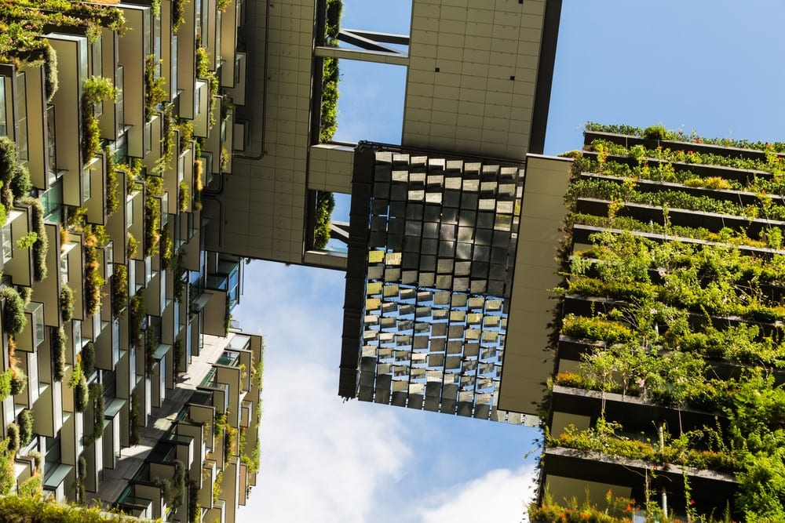

NetZero
An Active Passive Endeavor
Jennifer Pekarek

Slide 2
Table of Contents
A New Standard ……………………………………………….3-4
Ten steps to Net-Zero…………………………………….………5
The Heart of Net-Zero…………………………………………….6
Passive Design Strategies……………………………………7-14
Active Design Strategies……………………………………15-21
Summary…………………………………………………………..22
References………………………………………………………...23

Slide 3

Across the globe, countries are implementing a new standard of building that will hopefully help rectify the disastrous conditions this planet now faces. The common goal is to create a “NetZero” future, where everything we use to live, work, play, and gather must contribute zero emissions.

Slide 4
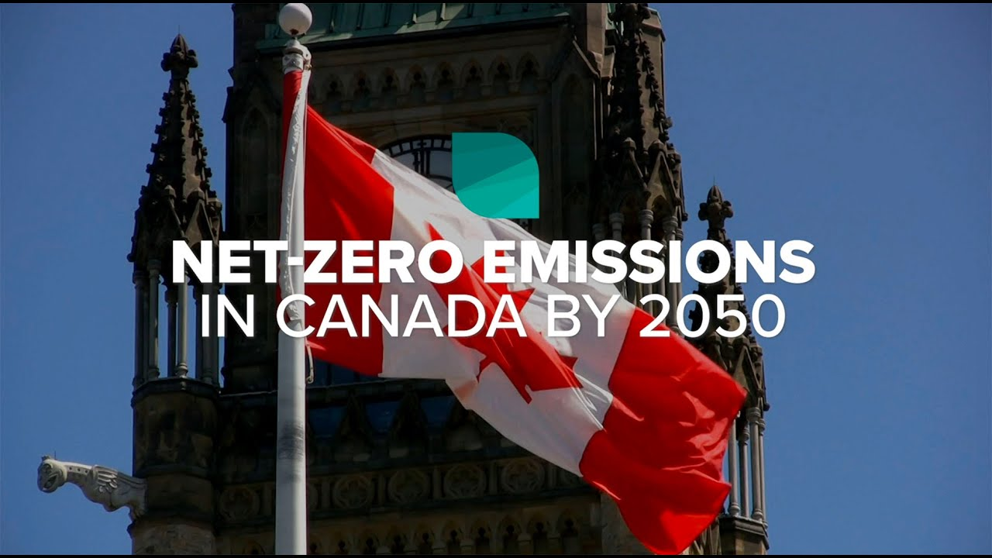
Canada has set forth a 30-year goal to reach a net-zero future by 2050.
Many agree it is a steep standard to reach.
However, many also agree it is imperative to reach this goal even sooner.
Although this new standard applies to all industries, our focus is on the building industry. All buildings or structures begin with the creation of a design based on the overall goals it will accomplish.
This goal now includes “net-zero”.

Slide 5
10 steps to reach net-zero:
How can we reach this goal?
1) Practice “Integrated Design Process” by collaborating between all parties involved in the overall build start to finish.
2) Use passive design.
3) During the design phase, use energy modelling.
4) Make an airtight envelope with whole house ventilation.
5) Use optimal insulation in floors, ceilings, and walls.
6) Select windows and doors based on performance, size, and orientation with goal of a balance between controlling thermal losses and maintaining a comfortable environment.
7) Select energy efficient heating, ventilation, and air conditioning.
8) Position energy efficient water heater closest to its needed location.
9) Install energy efficient lighting and appliances.
10) Add renewable energy sources (solar, wind, etc)

Slide 6
Components at the heart of net-zero building:
Passive Design
utilization of what nature provides (sun and wind patterns) to keep a building comfortable without use of purchased energy.
Active Building
usage of mechanical system components that utilize purchased energy and can include systems which generate energy (solar thermal panels, wind turbines, geothermal energy exchangers, etc) in order to create a comfortable building.

Slide 7
14 Passive Design Strategies:
Site-Optimization
Heritage Conservation
Passive Solar
Deep Overhangs
Natural Cross-Ventilation
Re-Use
Green Roof
Rainwater Collection
High-Efficiency Windows
Off-Grid
Permeable Paving
Above-Code Insulation
Insulated Concrete Forms (ICF)
Thermal Mass

Slide 8
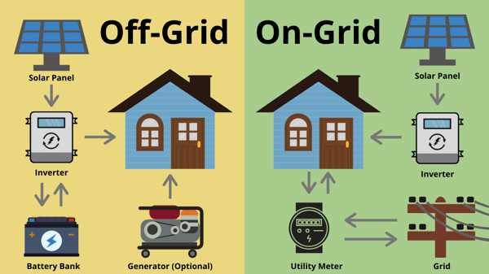
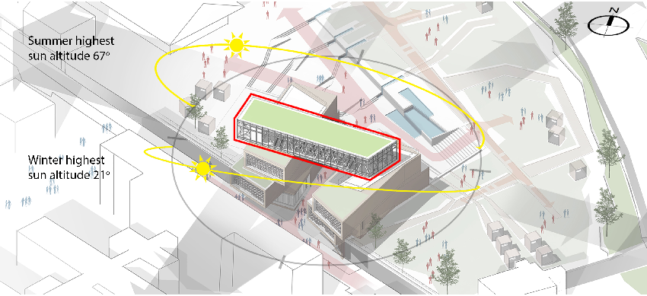
Site-Optimization
Selection of building site based on key factors such as:
Minimal disturbance to existing land
Mitigation of need for additional infrastructure
Opportunities for daylighting, solar heat, natural shading and ventilation
Off-Grid
Reliance on on-site resources rather than
on municipal water, sewer, natural gas, electrical power grid, and other utility services.

Slide 9
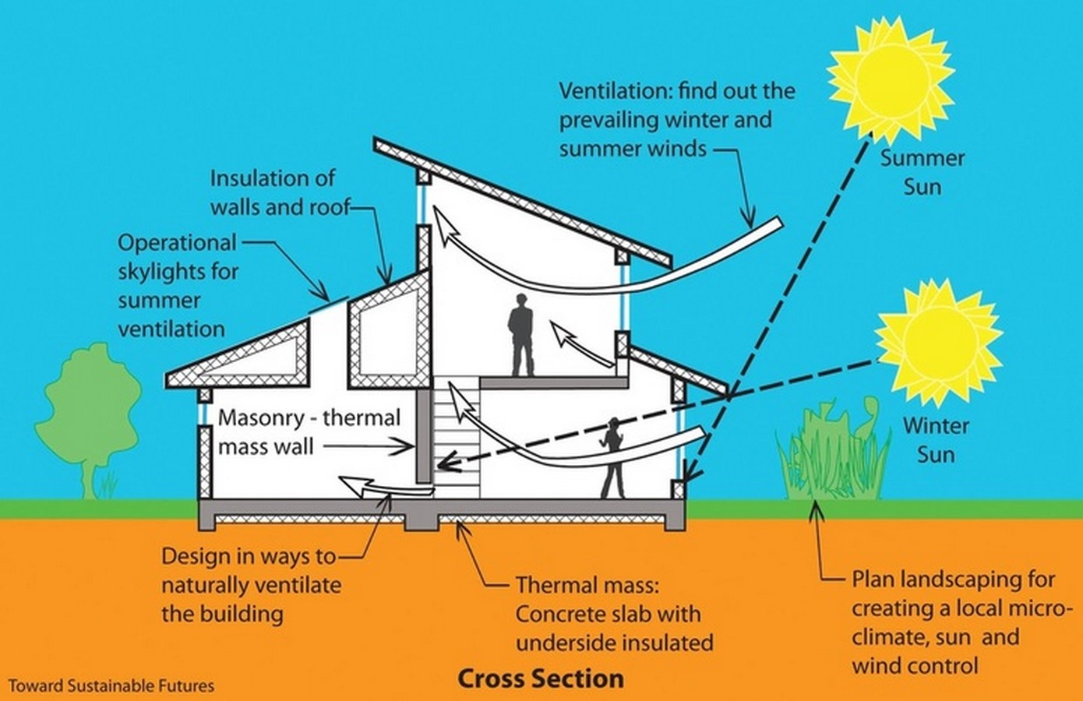
Passive Solar
Using air created by exposure to the sun’s energy in conjunction with natural properties of materials used for the heating and cooling living spaces.
Natural Cross-Ventilation
Windows and doors placed on windward side of building allow air to enter through positive pressure while exiting vertically through building on the leeward side through negative pressure.

Slide 10
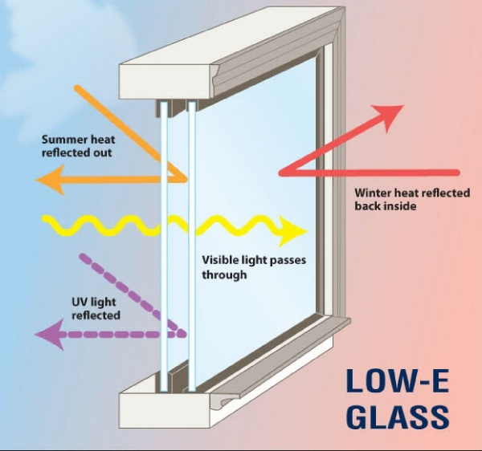
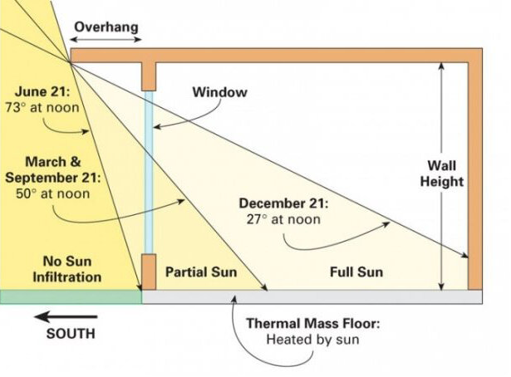
Deep Overhangs
Window shading that allows maximum heat gain in winter and minimal in the summer.
High-Efficiency Windows
Double or triple glazed windows with insulating gas between panes and a low-E coating that keep warm air out during summer and in during winter.

Slide 11
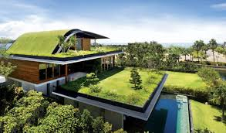
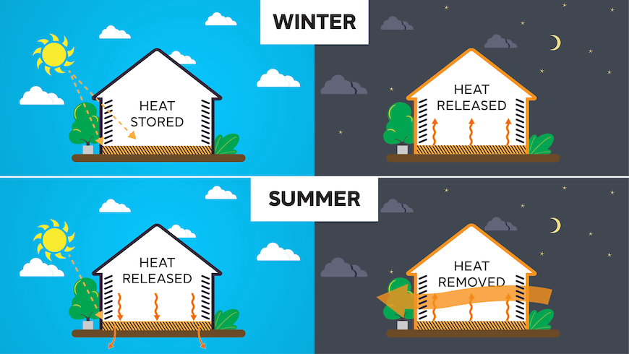
Thermal Mass
A material’s natural ability to absorb, store and release heat. Materials can be used with intention to act as natural temperature and humidity reducers.
Green Roof
A roof system consisting of a waterproofing membrane, drainage layers, a root barrier, a growing medium, vegetation, and an automatic irrigation system. The result is a cooling effect on the building, in addition to other positive effects.

Slide 12
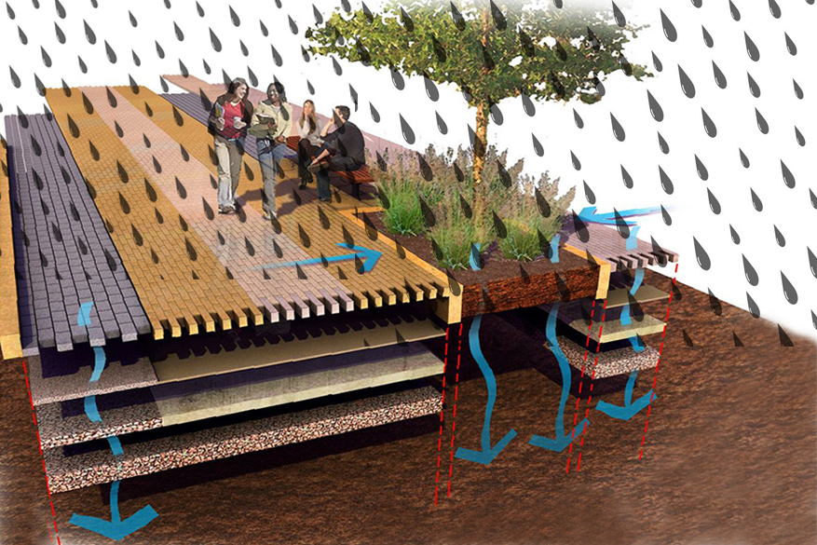
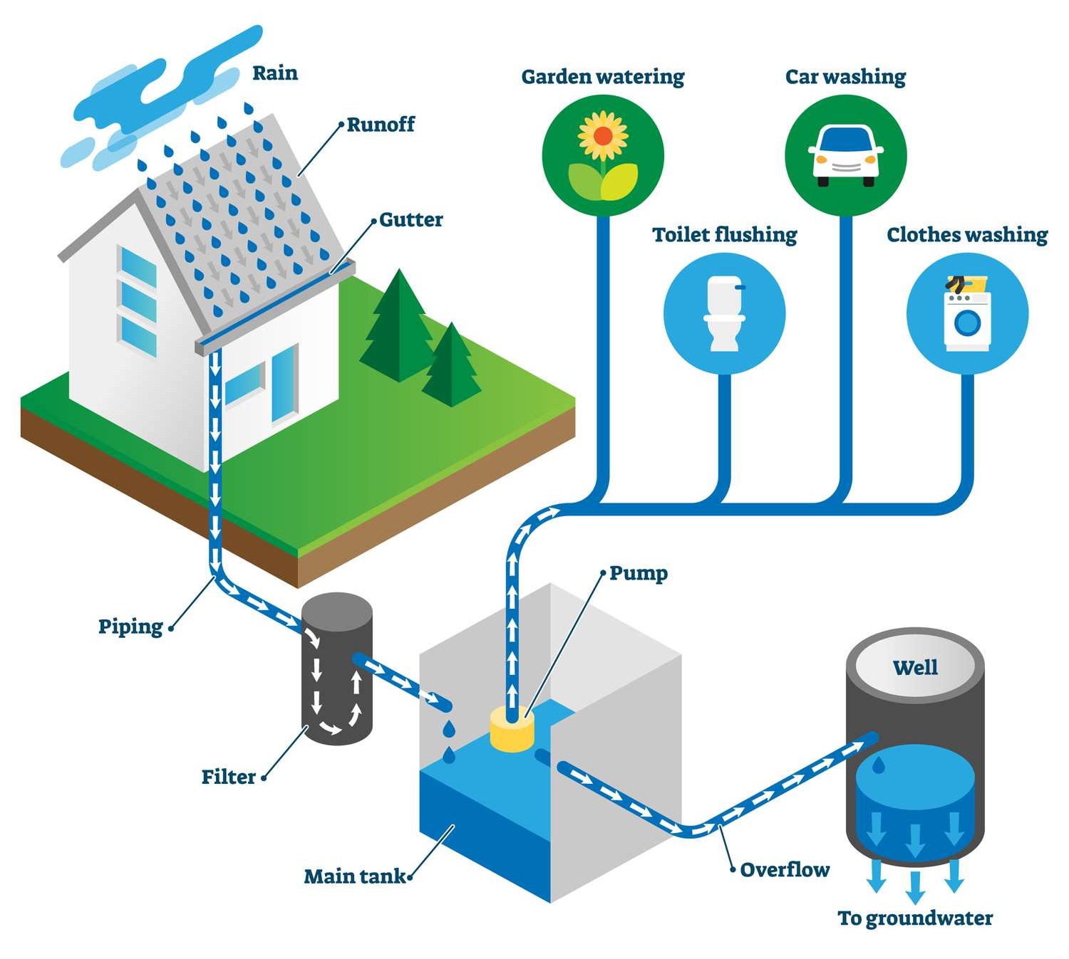
Rainwater Collection
Collecting runoff from horizontal surfaces on a building to be used later on the same property.
Permeable Paving
A type of paving which reduces runoff and filtering out contaminants before they enter groundwater.
Could we combine these into 1 system that collects all runoff?

Slide 13
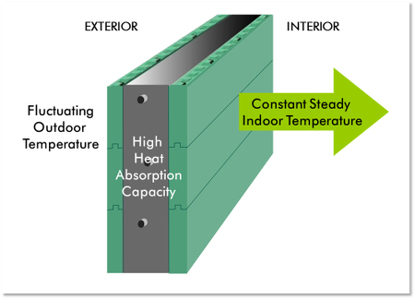
Above-Code Insulation
Usage of insulation rated:
R-60 in ceilings
R-40 in above grade walls
R-20 in basement walls
R-10 below and surrounding perimeter of basement slabs.
Insulated Concrete Forms (ICF)
Formwork blocks made of insulative materials that are stacked to create walls and filled with concrete.

Slide 14
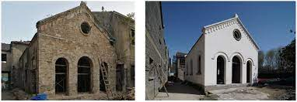
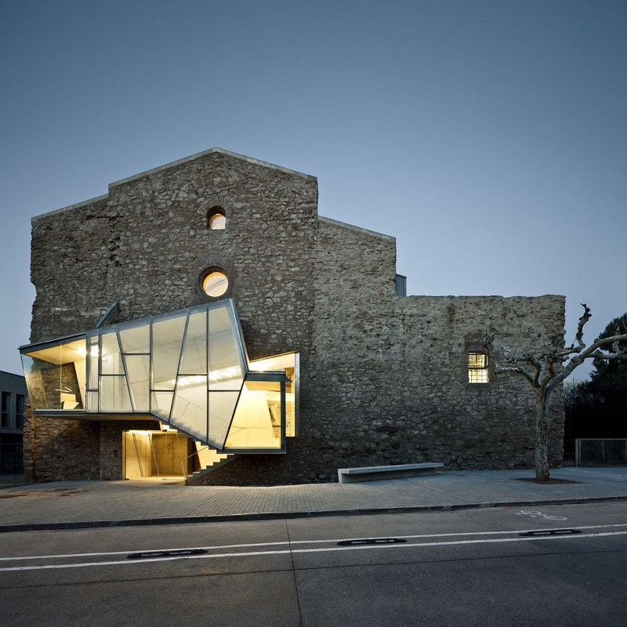
Re-Use
Changing the use of materials which are no longer needed to be used again for the same or another purpose.
Heritage Conservation
Re-use of existing building materials by extending the life of a building and its components, or rehabilitating damaged building materials.

Slide 15
12 Active Design Strategies:
Grid connected
Solar-Electrical Power
Solar Thermal Energy
Geothermal Heat Exchange
Wind Power
High Efficiency HVAC System
HRV/ERV
In-Floor Radiant Heating
Building Automation
Drain Water Heat Recovery
On-Demand Hot Water
Greywater Re-use

Slide 16
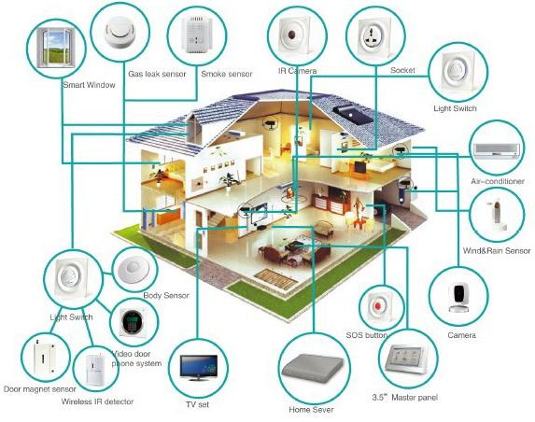
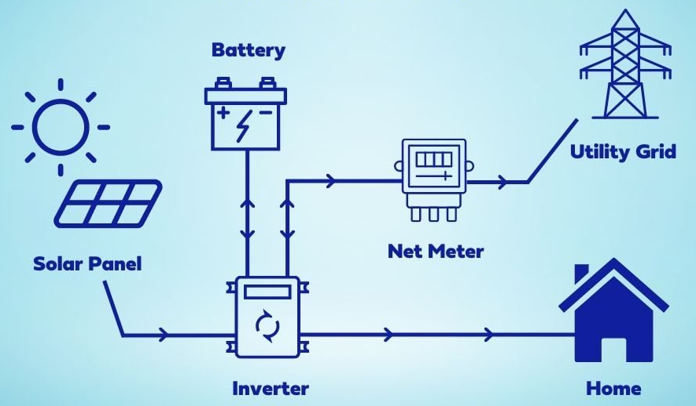
Grid connected
By connecting to the grid, a building can both use or generate energy. As long as the building generates the same or more energy than the grid, it will still be classified as net-zero.
** If more energy is generated, means money made! **
Hybrid
Building Automation
Systems within a building are networked together to monitor and control the systems in unison.
AKA: “Intelligent Buildings”
“Smart Homes”

Slide 17
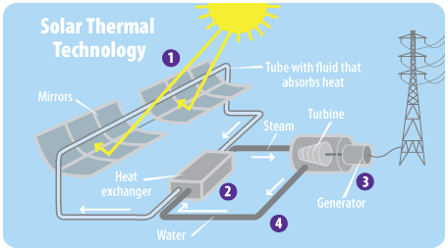
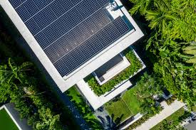
Solar-Electrical Power
Solar PV modules can be placed on roofs, used as sun shades, as cladding or on land next to a building to store electrical energy.
Solar Thermal Energy
Flat plate collectors placed on rooftops absorb heat from the sun by means of fluid within a circulated tube. The tube circulates hot water into an insulated water tank which an on-demand water heater can use to reduce electricity needs.

Slide 18
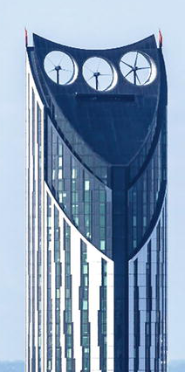
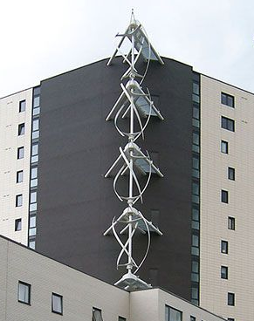
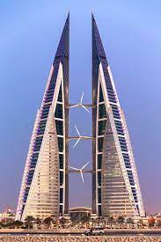
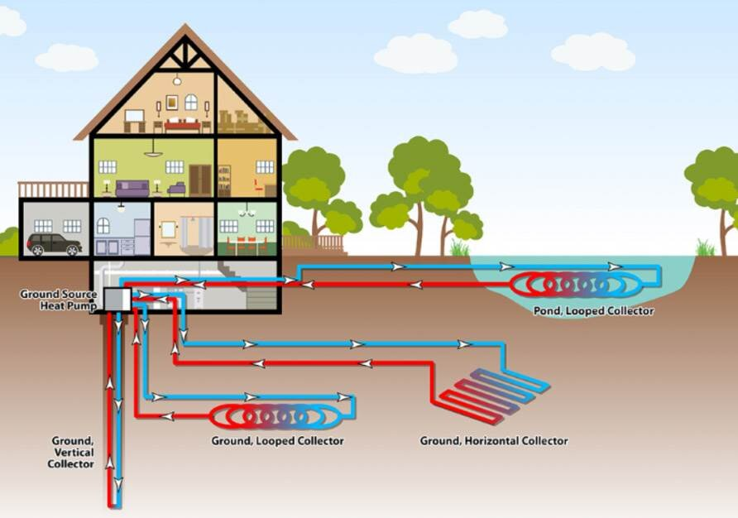
Geothermal Heat Exchange
Since temperatures 4-6 feet underground change minimally with seasons, pipes can be placed underground and connected to an indoor handling unit. During winter months this unit helps heat a building, while cooing it during the summer months.
Wind Power
Wind turbines convert energy from the wind into electricity that can be used. More recently these turbines have been seen integrated into superstructures.

Slide 19
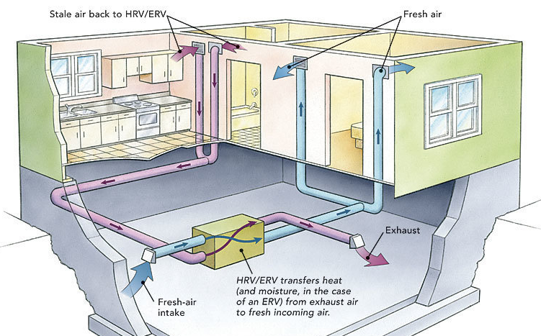
High Efficiency HVAC System
Selecting the correct HVAC system for a building can equal big savings on both energy usage and running costs. A building with many passive strategies in use will not require nearly as much energy as on that has non and therefore can use an HVAC system with lower energy consumption.
HRV/ERV
This system bring fresh outdoor air in then transfers heat and humidity from old exhaust air prior to delivering it throughout a building. By doing this, the building retains more heat and requires less energy to maintain its temperature.

Slide 20
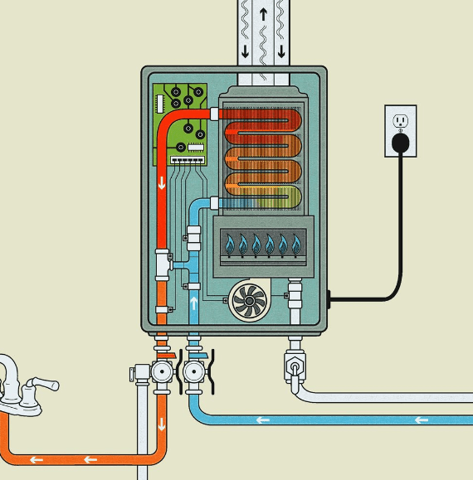
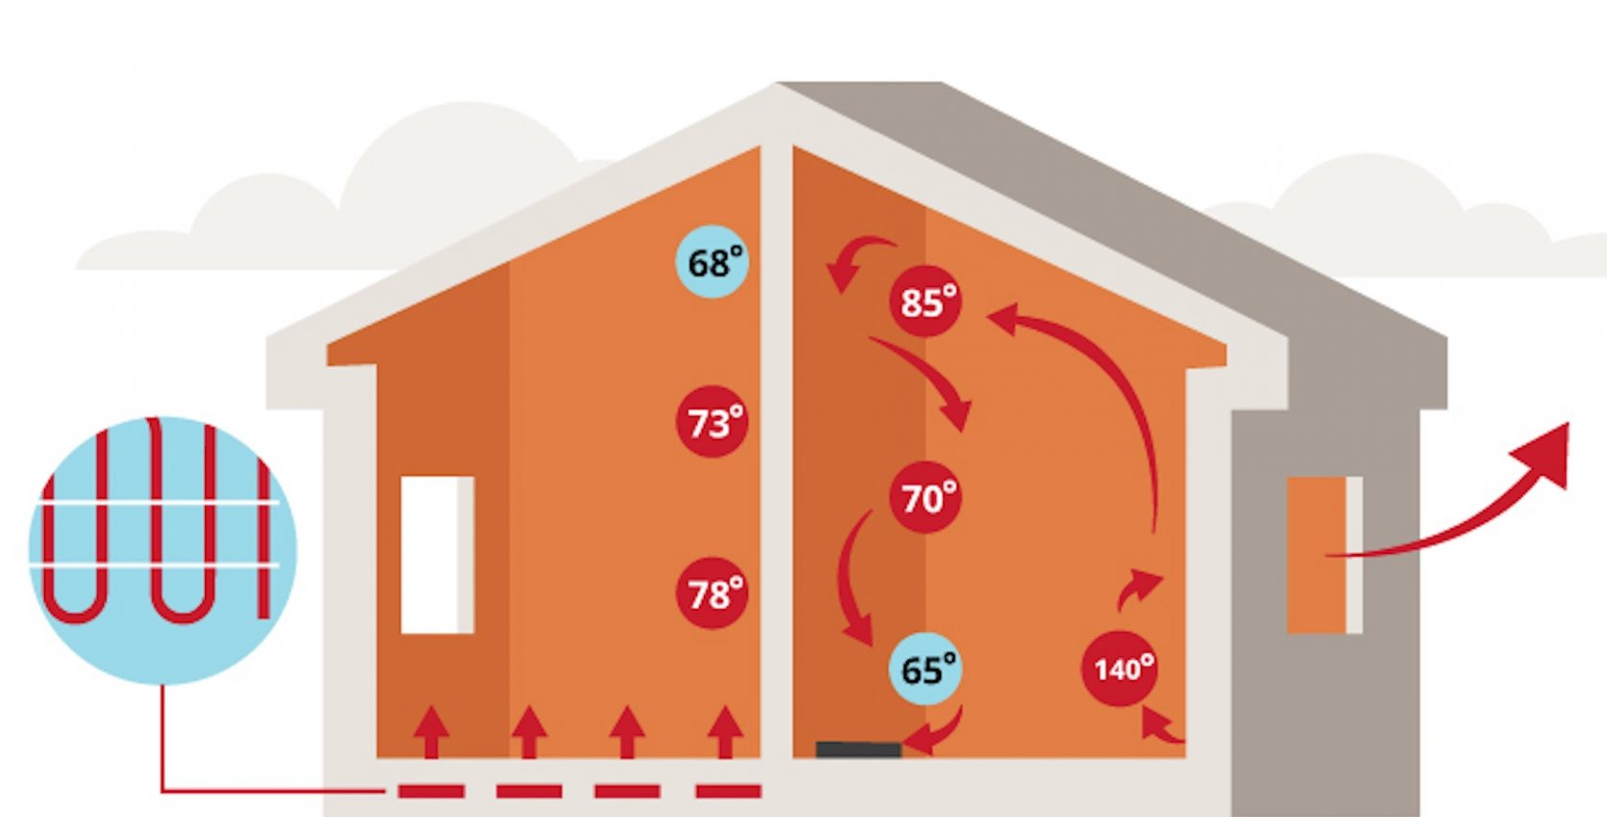
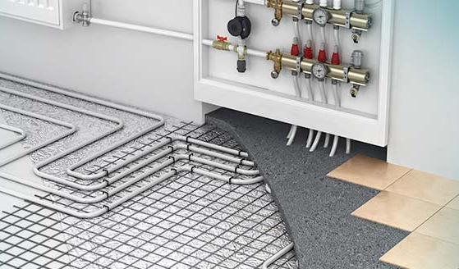
In-Floor Radiant Heating
By running tubes in the floor and exchanging heat between fluid that runs into these tubes, a substantially lower amount of energy is need to heat a building.
There’s no getting cold feet in these structures!
On-Demand Hot Water
Even if these units didn’t offer energy efficiency, they are still a must have with unlimited hot water and no wait time. No energy is wasted on keeping a tank full of hot water heated, just the water that is needed, when its needed.

Slide 21
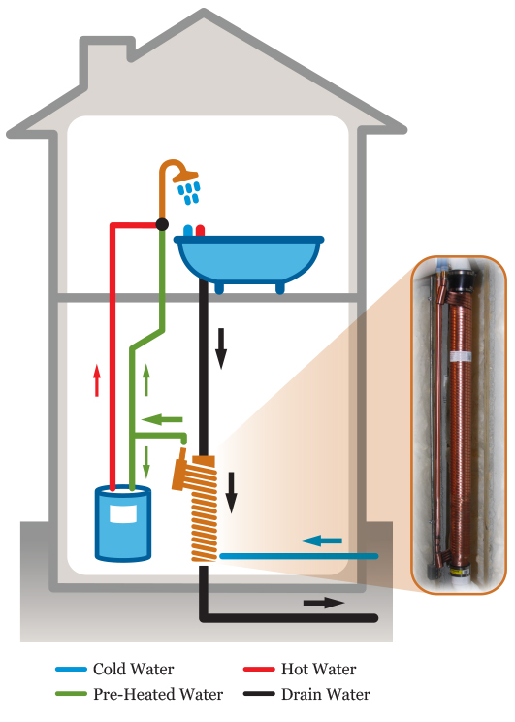
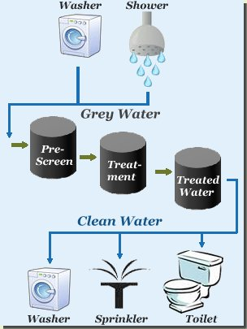
Drain Water Heat Recovery
Recovering the heat from water used within a home once it has entered the drainage system is a big energy saver. Energy from heat in this water is captured to preheat water prior entering a water heater.
Grey Water Re-use
The lifecycle of water used for cleaning doesn’t end with one use. This water can be collected and treated to be used for flushing toilets, irrigation, and reduction in need for potable water.
Could a hybrid system that combines instant water heaters, drain water heat recovery, and grey water re-use into one system?

Slide 22
Summary
While a net-zero future appears to be a daunting task, it isn’t out of reach. If we take every opportunity to implement components that lend to a net-zero design, we will get closer to this reality. Utilization of the aforementioned 14 passive and 12 active design strategies are crucial to Canada’s 2050 net-zero goal.
Whether working on a new build, a modification of an existing structure or a complete renovation, both passive and active designs can be implemented to help create this future.
Can you think of a project where some of the strategies discussed could be used?
Let’s start our net-zero future now.

Slide 23
Image References
Slide 1 images:
Procore. (2023) Retrieved from Procore.com website:
https://www.procore.com/jobsite/wp-content/uploads/2019/04/standard_iStock-943415440.jpg
Slide 8 images:
Paradise Energy Solutions. (2023) Retrieved from Paradise Energy Solutions website:
https://www.paradisesolaergy.com/hs-fs/hubfs/Imported_Blog_Media/off-grid-vs-on-grid-solar-system.png?width=600&name=off-grid-vs-on-grid-solar-system.png
Slide 9 images:
Pantic Architects. (2023) Retrieved from Pantic Architects website:
https://www.panticarchitects.com/img/serviceImgs/passive-systems.webp
Slide 10 images:
Whole Building Design Guide. (2023) Retrieved from WBDG(Whole Building Design Guide) website:
https://www.wbdg.org/images/suncontrol_04.jpg
Energy Education. Retrieved from Energy Education website:
https://energyeducation.ca/wiki/images/b/b5/491px-Innerglass-low-e-illustrati.jpg
Slide 11 images:
Greenesa. (2023) Retrieved from Greenesa website:
https://greenesa.com/uploads/images/thermal_mass_winter_summer_Greenesa_1637700073.png
Idei Club (2023) Retrieved from Idei Club website:
https://en.idei.club/uploads/posts/2023-03/thumbs/1679130923_en-idei-club-p-ecological-house-dizain-krasivo-2.jpg
Slide 12 images:
DotDash Merideth. (2004) Retrieved from TreeHugger website:
https://www.treehugger.com/thmb/4pzDXoNAExGMOr_wmTxtNHjT8JE=/750x0/filters:no_upscale():max_bytes(150000):strip_icc():format(webp)/rainwater-harvesting-system-isometric-diagram-1201105579-34cb7b27492f42c387b89fd903a16ba4.jpg
Research Gate. (2008) Retrieved from Research Gate website:
https://www.researchgate.net/profile/Edwin-Kipkirui/publication/339793739/figure/fig3/AS:867186189012996@1583764707898/Section-showing-how-permeable-paving-and-landscape-collects-rainwater-and-disseminates.jpg

Slide 24
Image References
Slide 13 images:
Palmer Construction. (2023) Retrieved from Palmer Construction Passive Building Systems website:
https://palmercon.ie/wp-content/uploads/2022/05/icf_temperature_diagram-300x215-1.png
Slide 14 images:
JL Architects. (2023) Retrieved from JL Architects website:
https://www.jlarchs.com/wp-content/uploads/2016/10/2e1ax_yoo_moustache_entry_Primary-Photo-Convent-de-Sant-Francesc.jpg
MDPI. (1996) Retrieved from MDPI website:
https://www.mdpi.com/buildings/buildings-11-00176/article_deploy/html/images/buildings-11-00176-g025-550.jpg
Slide 16 images:
Solar Square. (2023) Retrieved from Solar Square website:
https://www.solarsquare.in/blog/wp-content/uploads/2022/07/Blog-images-inside-1000800px-35-845x550.jpg
Paradise Energy Solutions. (2023) Retrieved from Paradise Energy Solutions website:
https://www.paradisesolaergy.com/hs-fs/hubfs/Imported_Blog_Media/off-grid-vs-on-grid-solar-system.png?width=600&name=off-grid-vs-on-grid-solar-system.png
Voltimum. (2023) Retrieved from Voltimum website:
https://d2uftzox6cgv09.cloudfront.net/sites/www.voltimum.com.au/files/styles/image_630/public/fields/main_image/smart-home_energy_0.jpg
Slide 17 images:
AD. (2023) Retrieved from AD(Architectural Design) website:
https://media.architecturaldigest.com/photos/607b0de2fecff4d852916452/16:9/w_1920,c_limit/AD0521_SUSTAINABILITY_2.jpg
EPA(2021). Retrieved from United States Environmental Protection website:
https://archive.epa.gov/climatechange/kids/images/4-1-1solar_thermal.gif

Slide 25
Image References
Slide 18 images:
Cooling India. (2004) Retrieved from Cooling India website:
https://i0.wp.com/www.coolingindia.in/wp-content/uploads/2018/10/geothermal-heatpump-sustainabledevelopment.jpg?w=792&ssl=1
Reddit. (2023) Retrieved from Reddit website:
https://www.reddit.com/media?url=https%3A%2F%2Fpreview.redd.it%2Fd4aykut9ca731.jpg%3Fauto%3Dwebp%26s%3D2925519d611112add228e07374eb15f52a7125f4
Pinterest. (2010) Retrieved from Pinterest website:
https://www.pinterest.ca/pin/532409987178874153/
Slide 19 images:
Fine Home Building. (2023) Retrieved from Fine Home Building website:
https://images.finehomebuilding.com/app/uploads/2014/11/05115558/021248086-fully-ducted-system_xlg.jpg
Slide 20 images:
Amazon. (1994) Retrieved from Amazon website:
https://m.media-amazon.com/images/S/aplus-media-library-service-media/7e091aa5-8ab2-4af0-9572-7f445f9809f3.__CR0,0,970,600_PT0_SX970_V1___.jpg
Warmup. (2023) Retrieved from Warmup website:
https://www.warmup.com/wp-content/uploads/radiant-heating-vs-forced-air-1920x857-1.jpg
Slide 21 images:
PHAM News. (2014) Retrieved from PHAM News website:
https://www.phamnews.co.uk/web-cont1001/uploads/Power-830x496.jpg
Pinterest. (2010) Retrieved from Pinterest website:
https://www.pinterest.ca/pin/gray-water-reusing-and-recycling-in-2023--567805465533068573/

